Slide 1
Rendering With DirectX 12
DFS 2 PROPOSAL
RAHUL GUPTA

Slide 2
What IS IT ?
Very Straight Forward as the title.
High Level goals –
Setting up the DirectX 12 Deferred Rendering Pipeline.
Setting Up the DirectX 12 Real Time Raytracing (DXR) Pipeline.

Slide 3

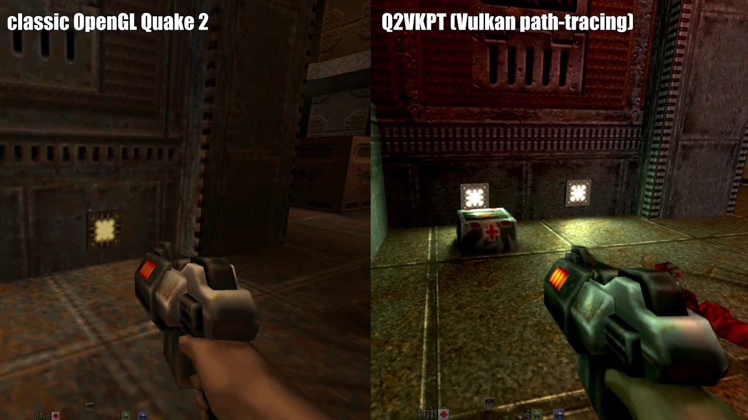
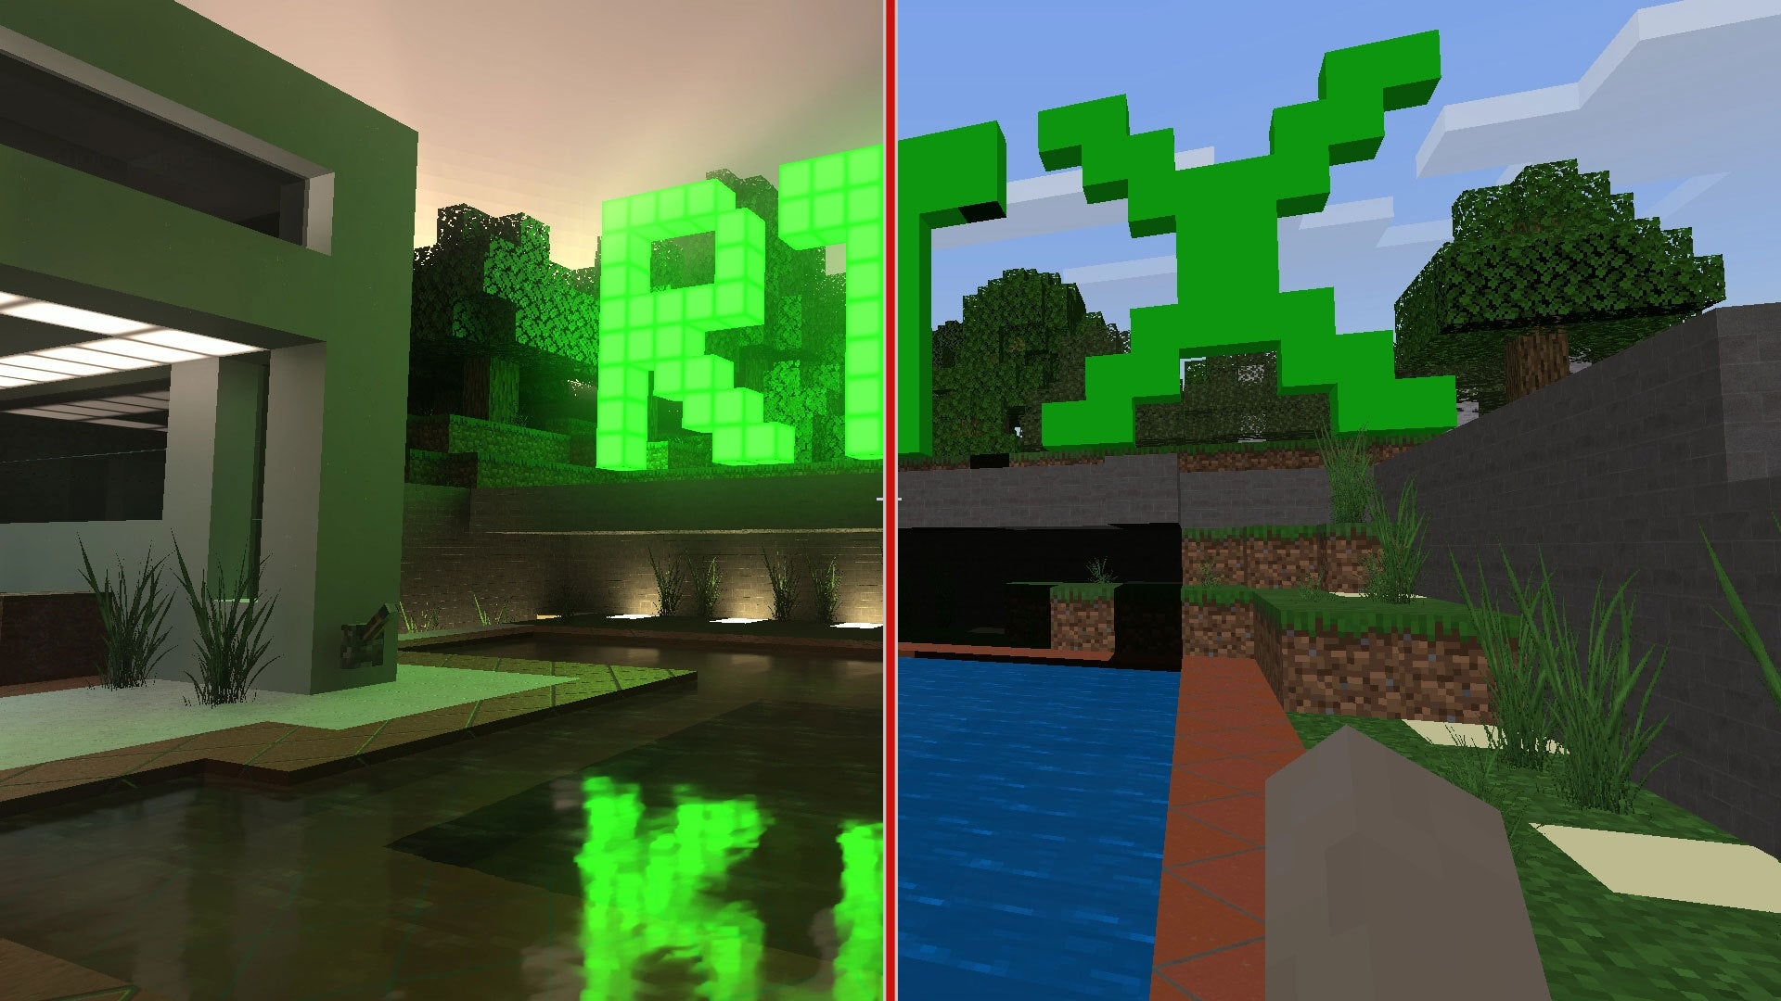
RENDERING AGAIN! WHY?
In the past few years Real Time Raytracing hardware has developed leaps and bounds and now after more than a decade it can be done at 60 FPS.
It is a very popular concept in graphics and games and only becoming more prevalent in the industry with the advancement in hardware technology.

Slide 4


Thank YOU

